Slide 1
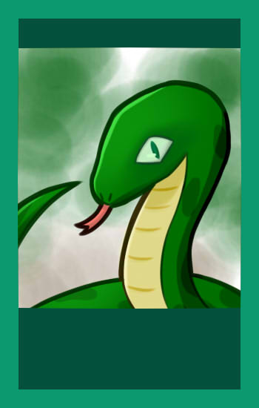
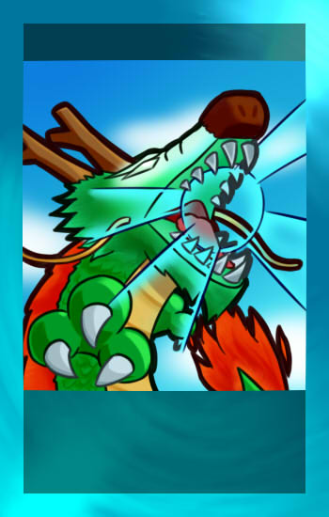
SNAKE
DRAGON
III
X
HP: 5
IT: Camouflage I, Environmental awareness I, speed ii
HP: 1
IT: Can Swim II, Can Fly II, Cold Resistance II, Heat resistance II, Camouflage II, Environmental Awareness II, Speed V, Multiple Food I

Slide 2

SNAKE
Winnie the pooh
III
IV
HP: 5
IT: Camouflage I, Environmental awareness I, speed ii
HP: 2
IT: Environmental awareness I

Slide 3
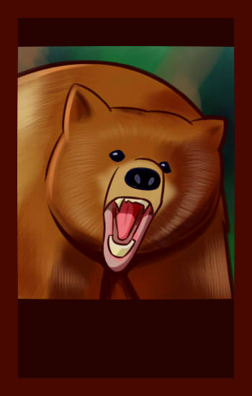
SNAKE
Bear
III
VI
HP: 5
IT: Camouflage I, Environmental awareness I, speed ii
HP: 6
IT: cold resistance iI, Environmental awareness I, speed iiI

Slide 4

SNAKE
Volcanic Eruption
III
ND
HP: 5
IT: Camouflage I, Environmental awareness I, speed ii
Bottleneck effect that kills species that don’t have Heat Resistance II.
Target: volcano; Scope: Region

Slide 5

drought
Volcanic Eruption
ND
ND
Bottleneck effect that kills species without heat resistance I or above or multiple food.
Scope: region
Bottleneck effect that kills species that don’t have Heat Resistance II.
Target: volcano; Scope: region

Slide 6

drought
human
ND
F
Bottleneck effect that kills species without heat resistance I or above or multiple food.
Scope: region
Changes species form, the effect will revert when environmental changes occur.
Scope: region

Slide 7

SNAKE
“Wireless” Mouse
III
I
HP: 5
IT: Camouflage I, Environmental awareness I, speed ii
HP: 4
IT: Camouflage I, speed iV

Slide 8
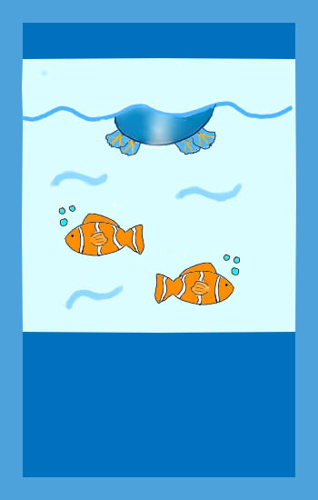
drought
Can swim
ND
Species develop gills, webbed feet, fins, etc. to swim.
Lv I - allows species to survive in “Swamp”, “Beach”, and “Waterfall Cliff”
Lv II - allows species to survive “Flood”
Lv III - allows species to swim to other regions
Bottleneck effect that kills species without heat resistance I or above or multiple food.
Scope: region

Slide 9

Can swim
Heat resistance
Species develop gills, webbed feet, fins, etc. to swim.
Lv I - allows species to survive in “Swamp”, “Beach”, and “Waterfall Cliff”
Lv II - allows species to survive “Flood”
Lv III - allows species to swim to other regions
Species enter a dormant state or reduce metabolism to resist heat.
Lv I - allows species to survive “Drought”
Lv II - allows species to survive in “Volcano” and “Volcanic Eruption”
Lv III - allows species to survive “Meteorite”

Slide 10

Can swim
Cold resistance
Species develop gills, webbed feet, fins, etc. to swim.
Lv I - allows species to survive in “Swamp”, “Beach”, and “Waterfall Cliff”
Lv II - allows species to survive “Flood”
Lv III - allows species to swim to other regions
Species develop fur, lipids, shells, etc. to resist coldness.
Lv I - allows species to survive in “Mountain”
Lv II - allows species to survive in “Ice Berg”
Lv III - allows species to survive “Ice Age”

Slide 11

drought
ND
meteorite
B
Bottleneck effect that kills species without heat resistance I or above or multiple food.
Scope: region
Bottleneck effect that kills species that don’t have Heat Resistance III
Target: volcanic eruption; scope: map

Slide 12
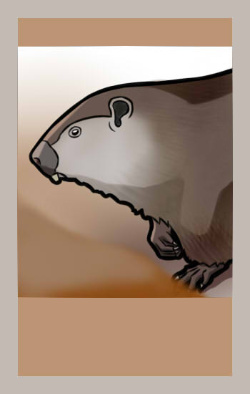
SNAKE
groundhog
III
II
HP: 5
IT: Camouflage I, Environmental awareness I, speed ii
HP: 4
IT: Camouflage I, Environmental awareness I, multiple food i

Slide 13
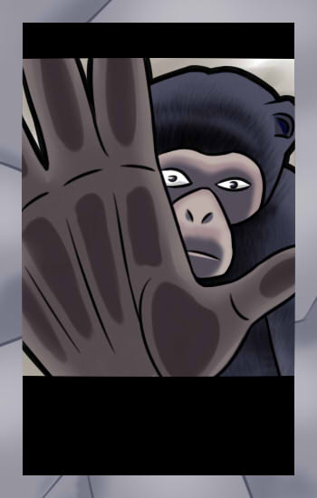
SNAKE
ape
III
VI
HP: 5
IT: Camouflage I, Environmental awareness I, speed ii
HP: 5
IT: environmental awareness ii, speed ii, multiple food i

Slide 14

Can swim
Can fly
Species develop gills, webbed feet, fins, etc. to swim.
Lv I - allows species to survive in “Swamp”, “Beach”, and “Waterfall Cliff”
Lv II - allows species to survive “Flood”
Lv III - allows species to swim to other regions
Species develop wings to fly.
Lv I - allows species to survive in “Mountain”
Lv II -
Lv III - allows species to fly to other regions

Slide 15

drought
ND
Ice age
nd
Bottleneck effect that kills species without heat resistance I or above or multiple food.
Scope: region
Bottleneck effect that kills species that don’t have cold Resistance III
Target: ice berg; scope: map

Slide 16

SNAKE
(hot) dog
III
i
HP: 5
IT: Camouflage I, Environmental awareness I, speed ii
HP: 2
IT: cold resistance iii

Slide 17

SNAKE
grass
III
0
HP: 5
IT: Camouflage I, Environmental awareness I, speed ii
HP: 1
IT: cold resistance I heat resistance i

Slide 18
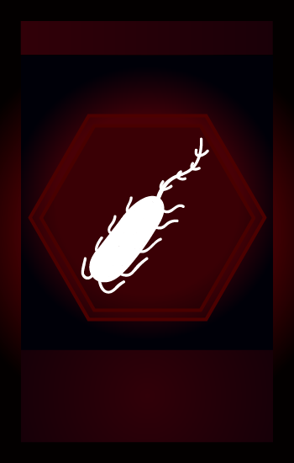
drought
ND
plague
e
Bottleneck effect that kills species without heat resistance I or above or multiple food.
Scope: region
Roll a dice:
Dice points 1, 2, 3 choose 1 species to kill
Dice points 4, 5, 6 choose 2 species to kill
remaining species earn Immunity (trait)
Scope: region

Slide 19

drought
ND
mutation
f
a
g
c
t
a
a
c
g
u
u
Bottleneck effect that kills species without heat resistance I or above or multiple food.
Scope: region
Changes species form.
Scope: individual

Slide 20

drought
human
ND
mutation
f
f
a
g
c
t
a
a
c
g
u
u
Bottleneck effect that kills species without heat resistance I or above or multiple food.
Scope: region
Changes species form.
Scope: individual
Changes species form,
Disappearing upon environmental changes.
Scope: individual

Slide 21
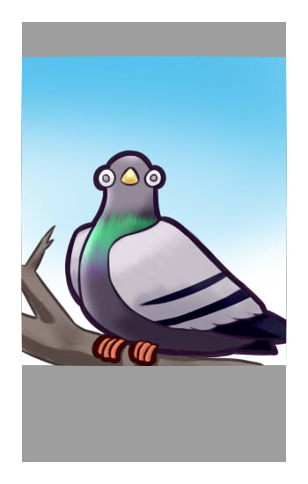
SNAKE
pigeon
III
III
HP: 5
IT: Camouflage I, Environmental awareness I, speed ii
HP: 2
IT: Can fly I, Environmental awareness I, speed i

Slide 22

Can swim
camouflage
Species develop gills, webbed feet, fins, etc. to swim.
Lv I - allows species to survive in “Swamp”, “Beach”, and “Waterfall Cliff”
Lv II - allows species to survive “Flood”
Lv III - allows species to swim to other regions
Species change their appearance to mimic the surroundings.
Lv I - predator fails to hunt down the prey if rolling 1 or 2.
Lv II - predator fails to hunt down the prey if rolling 1, 2, or 3.
Lv III - predator fails to hunt down the prey if rolling 1, 2, 3, or 4.

Slide 23

drought
ND
flood
nd
Bottleneck effect that kills species without heat resistance I or above or multiple food.
Scope: region
Bottleneck effect that kills species without Can Swim II or above.
Scope: region

Slide 24
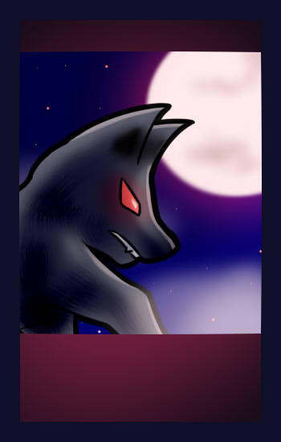
SNAKE
wolf
III
III
HP: 5
IT: Camouflage I, Environmental awareness I, speed ii
HP: 6
IT: cold resistance ii, Environmental awareness I, speed ii

Slide 25
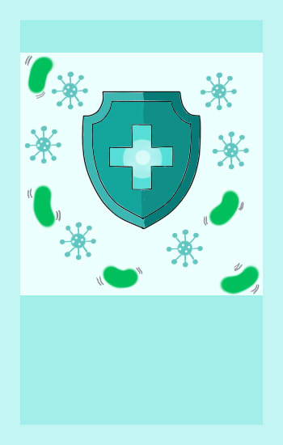
Can swim
immunity
Species develop gills, webbed feet, fins, etc. to swim.
Lv I - allows species to survive in “Swamp”, “Beach”, and “Waterfall Cliff”
Lv II - allows species to survive “Flood”
Lv III - allows species to swim to other regions
Species produce antibiotics and become immune to certain diseases.
Survive plague for once

Slide 26

drought
ND
tornado
nd
Bottleneck effect that kills species without heat resistance I or above or multiple food.
Scope: region
Bottleneck effect, if can fly, reduce Can Fly level by 1; if else, blown to next region clockwise.
Scope: region

Slide 27

drought
ND
Forest fire
nd
Bottleneck effect that kills species without heat resistance I or above or multiple food.
Scope: region
Bottleneck effect that kills species without heat resistance III and multiple food.
Target: forest; Scope: region

Slide 28
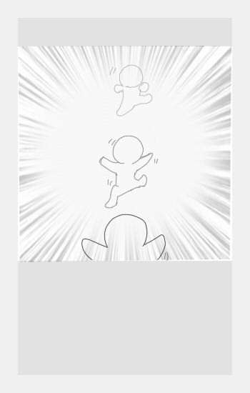
Can swim
speed
Species develop gills, webbed feet, fins, etc. to swim.
Lv I - allows species to survive in “Swamp”, “Beach”, and “Waterfall Cliff”
Lv II - allows species to survive “Flood”
Lv III - allows species to swim to other regions
Animals develop strong muscles or special functions to improve their agility.
Species’ HP increases by 1 every level increased

Slide 29

Can swim
Trait extension
Species develop gills, webbed feet, fins, etc. to swim.
Lv I - allows species to survive in “Swamp”, “Beach”, and “Waterfall Cliff”
Lv II - allows species to survive “Flood”
Lv III - allows species to swim to other regions
Species further adapt to enhance their abilities.
Raises the chosen trait by one level

Slide 30
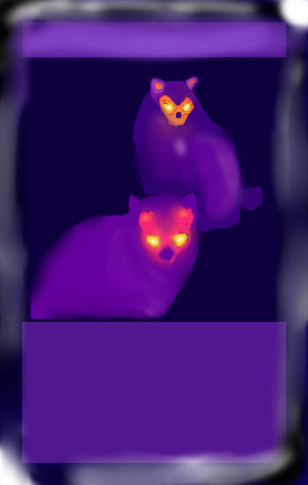

Can swim
Species develop gills, webbed feet, fins, etc. to swim.
Lv I - allows species to survive in “Swamp”, “Beach”, and “Waterfall Cliff”
Lv II - allows species to survive “Flood”
Lv III - allows species to swim to other regions
Species develop sensitive organs to sense stimuli and react faster.
Species’ HP increases by 2 every level increased

Slide 31
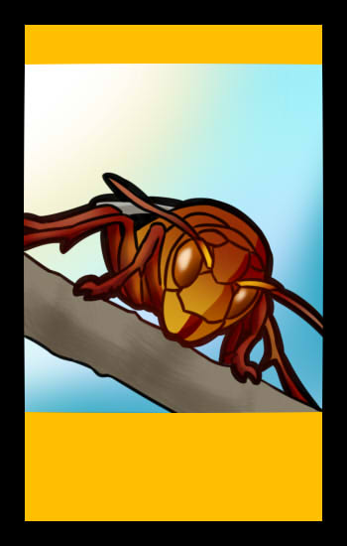
SNAKE
hornet
III
III
HP: 5
IT: Camouflage I, Environmental awareness I, speed ii
HP: 4
IT: can fly ii heat resistance I, speed i

Slide 32

SNAKE
Honey bee
III
II
HP: 5
IT: Camouflage I, Environmental awareness I, speed ii
HP: 2
IT: can fly ii

Slide 33
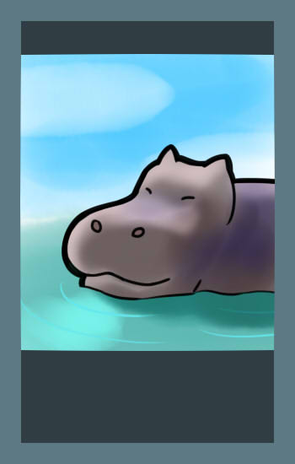
SNAKE
hippo
III
V
HP: 5
IT: Camouflage I, Environmental awareness I, speed ii
HP: 7
IT: can swim ii cold resistance ii multiple food i

Slide 34

SNAKE
monkey
III
iV
HP: 5
IT: Camouflage I, Environmental awareness I, speed ii
HP: 4
IT: environmental awareness i speed iii

Slide 35
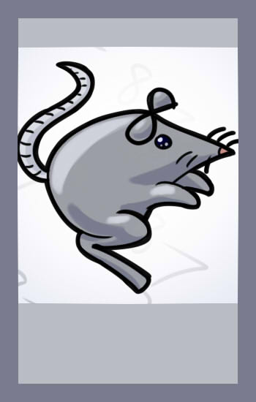
SNAKE
mouse
III
ii
HP: 5
IT: Camouflage I, Environmental awareness I, speed ii
HP: 3
IT: speed iii, multiple food i

Slide 36

Can swim
Multiple food
Species develop gills, webbed feet, fins, etc. to swim.
Lv I - allows species to survive in “Swamp”, “Beach”, and “Waterfall Cliff”
Lv II - allows species to survive “Flood”
Lv III - allows species to swim to other regions
Species develops traits / methods allowing them to obtain more food.
Lv I - allows species to survive “Drought”

Slide 37


Can swim
Species develop gills, webbed feet, fins, etc. to swim.
Lv I - allows species to survive in “Swamp”, “Beach”, and “Waterfall Cliff”
Lv II - allows species to survive “Flood”
Lv III - allows species to swim to other regions
Increases HP by 2
Max level: VI

Slide 38


Can swim
Can swim
Species develop gills, webbed feet, fins, etc. to swim.
Lv I - allows species to survive in “Swamp”, “Beach”, and “Waterfall Cliff”
Lv II - allows species to survive “Flood”
Lv III - allows species to swim to other regions
Increases HP by 2
Max level: VI
LV II: survives flood
Max level: III

Slide 39
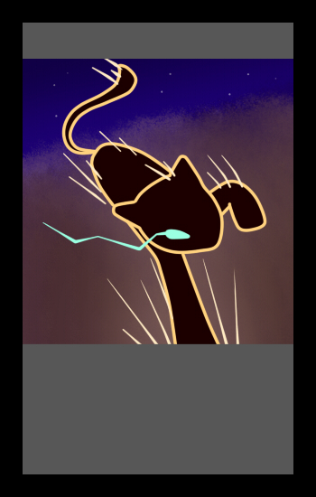
Can swim
Speed
Species develop gills, webbed feet, fins, etc. to swim.
Lv I - allows species to survive in “Swamp”, “Beach”, and “Waterfall Cliff”
Lv II - allows species to survive “Flood”
Lv III - allows species to swim to other regions
Increases HP by 2
Max level: III
Increases HP by 1
Max level: VI

Slide 40

Can swim
camouflage
Species develop gills, webbed feet, fins, etc. to swim.
Lv I - allows species to survive in “Swamp”, “Beach”, and “Waterfall Cliff”
Lv II - allows species to survive “Flood”
Lv III - allows species to swim to other regions
Increases HP by 2
Max level: III
LV I: dodge attack (33%)
LV II: dodge attack (50%)
LV III: dodge attack (66%)
Max level: III

Slide 41
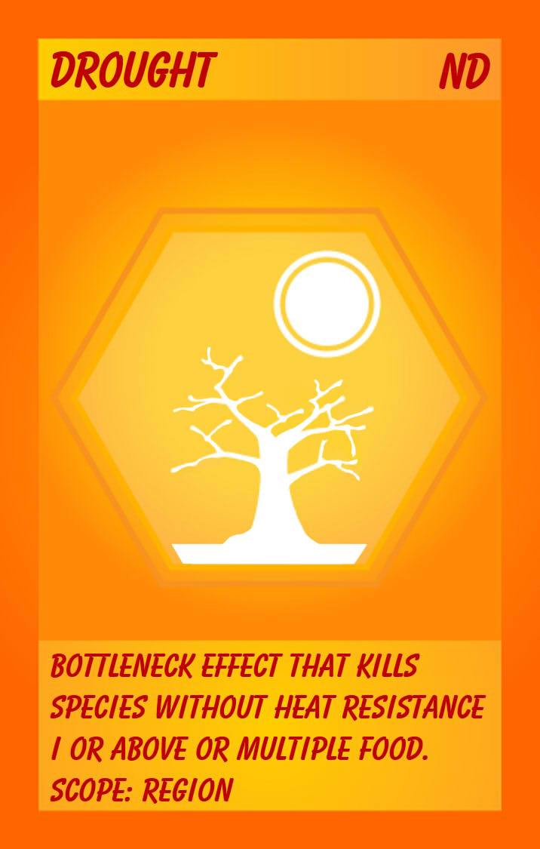

drought
Flood
ND
Forest fire
nd
nd
kills species without
heat resistance I or above or multiple food I
Scope: Individual
kills species without
heat resistance III and
multiple food I
Scope: Individual
kills species without
Can Swim II
Scope: Individual

Slide 42

Can swim
Trait extension
Species develop gills, webbed feet, fins, etc. to swim.
Lv I - allows species to survive in “Swamp”, “Beach”, and “Waterfall Cliff”
Lv II - allows species to survive “Flood”
Lv III - allows species to swim to other regions
Increases HP by 2
Max level: III
Becomes any chosen trait

Slide 43

drought
meteorite
ND
Forest fire
B
nd
kills species without
heat resistance I or above or multiple food I
Scope: Individual
kills species without
heat resistance III and
multiple food I
Scope: Individual
kills species without
Heat resistance iii
Target: Volcanic eruption Scope: map

Slide 44
Volcanic eruption
meteorite
nd
B
kills species without
heat resistance I or above or multiple food I
Scope: Individual
kills species without
heat resistance II or above
Scope: Individual
kills species without
Heat resistance iii
Target: Volcanic eruption Scope: map

Slide 45
drought
ND
Forest fire
plague
nd
e
kills species without
heat resistance I or above or multiple food I
Scope: Individual
kills species without
heat resistance III and
multiple food I
Scope: Individual
Kills species without immunity:
kills 1 species (50%)
kills 2 species (50%)
Gives remaining species immunity
Scope: region

Slide 46

drought
ND
Forest fire
Ice Age
nd
ND
kills species without
heat resistance I or above or multiple food I
Scope: Individual
kills species without
heat resistance III and
multiple food I
Scope: Individual
kills species without
Cold Resistance iii
Scope: Map

Slide 47

Can swim
Multiple Food
Species develop gills, webbed feet, fins, etc. to swim.
Lv I - allows species to survive in “Swamp”, “Beach”, and “Waterfall Cliff”
Lv II - allows species to survive “Flood”
Lv III - allows species to swim to other regions
Increases HP by 2
Max level: III
LV i: survives drought
Max level: i

Slide 48
drought
ND
Forest fire
tornado
nd
ND
kills species without
heat resistance I or above or multiple food I
Scope: Individual
kills species without
heat resistance III and
multiple food I
Scope: Individual
Reduce can fly level by 1
If species cannot fly, blow to the next region
Scope: map

Slide 49
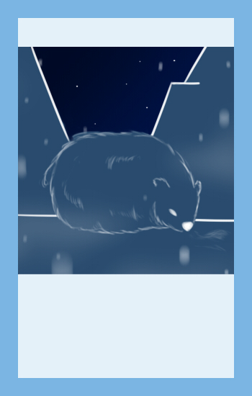
Can swim
Cold Resistance
Species develop gills, webbed feet, fins, etc. to swim.
Lv I - allows species to survive in “Swamp”, “Beach”, and “Waterfall Cliff”
Lv II - allows species to survive “Flood”
Lv III - allows species to swim to other regions
Increases HP by 2
Max level: III
LV iii: survives Ice Age
Max level: III

Slide 50

Can swim
Immunity
Species develop gills, webbed feet, fins, etc. to swim.
Lv I - allows species to survive in “Swamp”, “Beach”, and “Waterfall Cliff”
Lv II - allows species to survive “Flood”
Lv III - allows species to swim to other regions
Increases HP by 2
Max level: III
Survives plague for once
Max level: unlimited

Slide 51

Can swim
Can fly
Species develop gills, webbed feet, fins, etc. to swim.
Lv I - allows species to survive in “Swamp”, “Beach”, and “Waterfall Cliff”
Lv II - allows species to survive “Flood”
Lv III - allows species to swim to other regions
Increases HP by 2
Max level: III
Max level: III

Slide 52
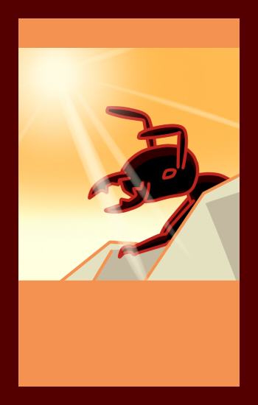
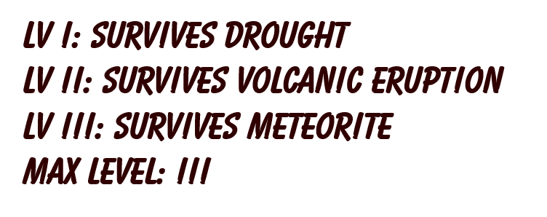
Can swim
Heat resistance
Species develop gills, webbed feet, fins, etc. to swim.
Lv I - allows species to survive in “Swamp”, “Beach”, and “Waterfall Cliff”
Lv II - allows species to survive “Flood”
Lv III - allows species to swim to other regions
Increases HP by 2
Max level: III

